Slide 1
Quiz 1 Review

Slide 2
What is Psychology
The scientific study of mind and behavior.

Slide 3
History of Psychology
Wundt (the first psychologist) and Structuralism
- What is structuralism?
James and Functionalism
- What is functionalism?
Freud and Psychoanalytic Theory
Gestalt Psychology
Behaviorism
- What is behaviorism?

Slide 4
Approaches to Studying Psychology
Biological approach: Focuses on the psychological effects of hormones, genes, and the activity of the nervous system, esp. the brain.
Evolutionary approach: Behavior and mental processes are the result of evolution.
Cognitive approach:
How we take in, mentally present, and store info
How we perceived and process info
How all these cognitive processes affect our behavior

Slide 5
Subfields of Psychology
For example:
Developmental psychology
Social psychology
Personality psychology
Industrial/Organizational Psychology

Slide 6
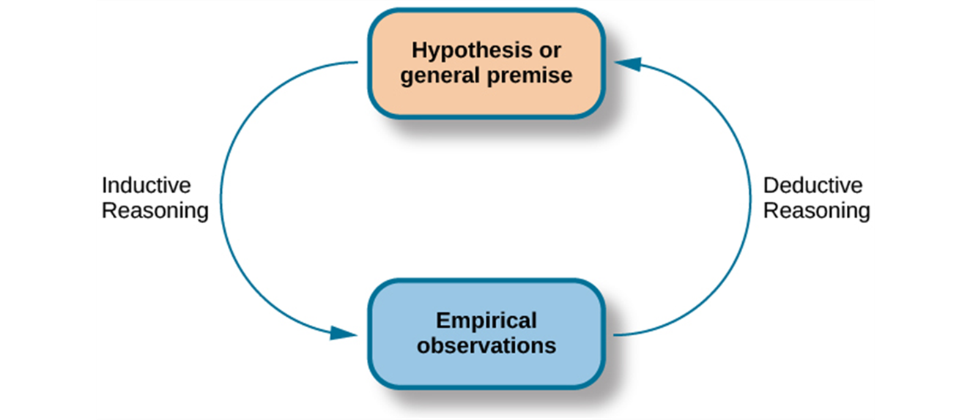
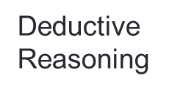
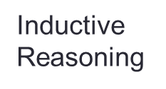
The Process of Scientific Method
Inductive vs. Deductive Reasoning

Slide 7
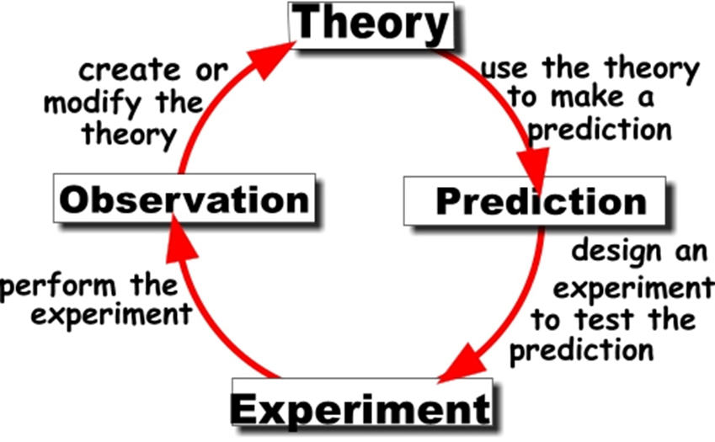
Key Elements in Research
Hypothesis: null and research hypothesis
Operational definition:
Independent vs. Dependent variable
Theory:

Slide 8
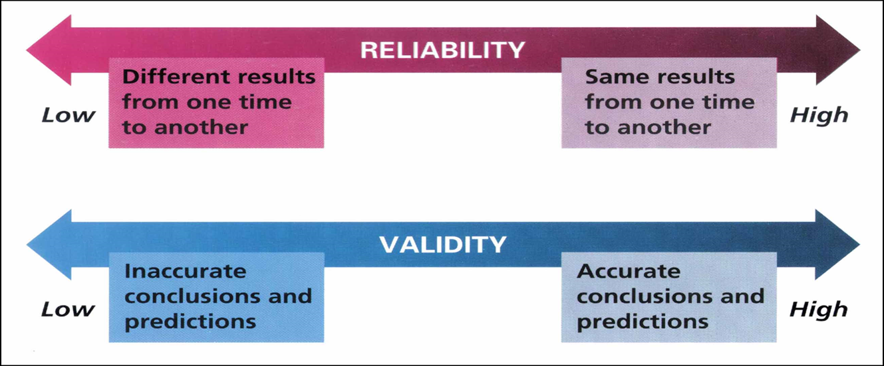
Reliability and Validity

Slide 9
Research Methods
Observational method
Case studies
Surveys
What are the pros and cons of each method?

Slide 10
Correlational Studies
Examines relationships between variables in order to analyze trends in data, test predictions, evaluate theories, and suggest new hypotheses.
Problems? Correlation does NOT mean causation!

Slide 11
Experiments
A research method in which the experimenter manipulates one variables and then observes the effect of that manipulation on another variable, while holding all other variables constant.
Experimental vs. Control Group
Random assignment of participants
Placebo effects
Double-blinded design: the participants do not know if they are in the experimental group or not, and the experimenters do not know that either.

Slide 12
Selecting Participants
Random Sample: each person in the population of interest has an equal chance of being selected.
For example: How to randomly select 100 individuals from a population of 500
Number each individual (1-500)
Put all the numbers into a hat
Draw 100 numbers from the hat randomly

Slide 13
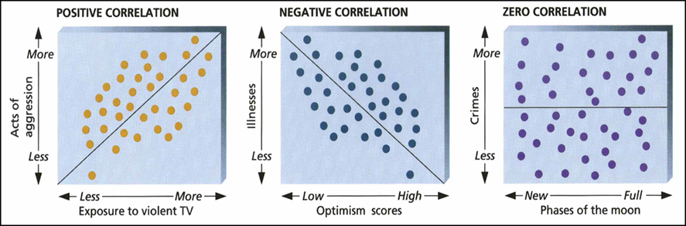
Statistics: Correlation
The degree to which one variable is related to another.
Positive correlation: X and Y change in same direction
Negative correlation: X and Y change in opposite direction
Range of correlation coefficient: -1 to +1 (e.g., -0.9 indicates very strong negative correlation between X and Y; 0.5 indicates moderate positive relationship between X and Y)

Slide 14
Sample questions
Psychology is a social science discipline. Psychologists scientifically study ________.
A. only behavior
B. only the mind
C. the mind and behavior
D. the soul, the mind, and behavior

Slide 15
According to William James, the purpose of psychology was to ________.
A. interpret dreams
B. manipulate human behavior
C. study the function of behavior
D. study the structure and characteristics of the mind

Slide 16
Penelope studies how the structure and function of the nervous system is related to behavior. She is a ________.
A. biological psychologist
B. developmental psychologist
C. humanist
D. social psychologist

Slide 17
Lucy wants to study changes in cognitive skills, moral reasoning, and social behavior across the lifespan. Lucy should specialize in ________ psychology.
A. cognitive
B. developmental
C. personality
D. social

Slide 18
Which correlation coefficient best represents a moderate relationship showing fewer anxiety symptoms in people who report higher life satisfaction?
A. –0.5
B. –0.2
C. +0.4
D. +0.7

Slide 19
Krista and Tatiana Hogan are participants in a(n) ________ of conjoined twins who are joined at the head.
A. case study
B. experiment
C. naturalistic observation
D. survey

Slide 20
Which of the following research designs will allow cause-and-effect conclusions?
A. correlational
B. experimental
C. observation
D. survey

Slide 21
A(n) ________ is a description of how the researchers will measure the variables of interest.
A. experimental plan
B. hypothesis
C. operational definition
D. theory

Slide 22
An intelligence test yields the same results when administered on three separate occasions. However, the test’s results are more strongly correlated with hours spent doing homework than they are with other standardized intelligence tests. This test has________ reliability and ________ validity.
A. high; high
B. high; low
C. low; high
D. low; low

